Slide 1

Starter Task
Continue working on your Photography Genres presentation from last time if you have not finished
If finished, check your feedback

Slide 2
Learning intentions and success criteria
I am learning…
I can…
About software development methodologies
The phases of iterative development
Describe the phases of an iterative development process

Slide 3

Development Methodologies
N5 - Software Design & Development

Slide 4

Introduction
Software design is a process with definite phases:
When you code a computer program, you do it in stages
Often, stages of the process in a cycle are repeated until a satisfactory piece of software is finalised.

Slide 5

An Analogy
Imagine you work in a bakery. You are tasked to bake a cake which will sell well in the shop.
Analysis
“What kind of cake should I bake?”
You start by figuring out what kind of cake your guests would love.
Does it need to be gluten free? Vegan? Is it a wedding cake?

Slide 6
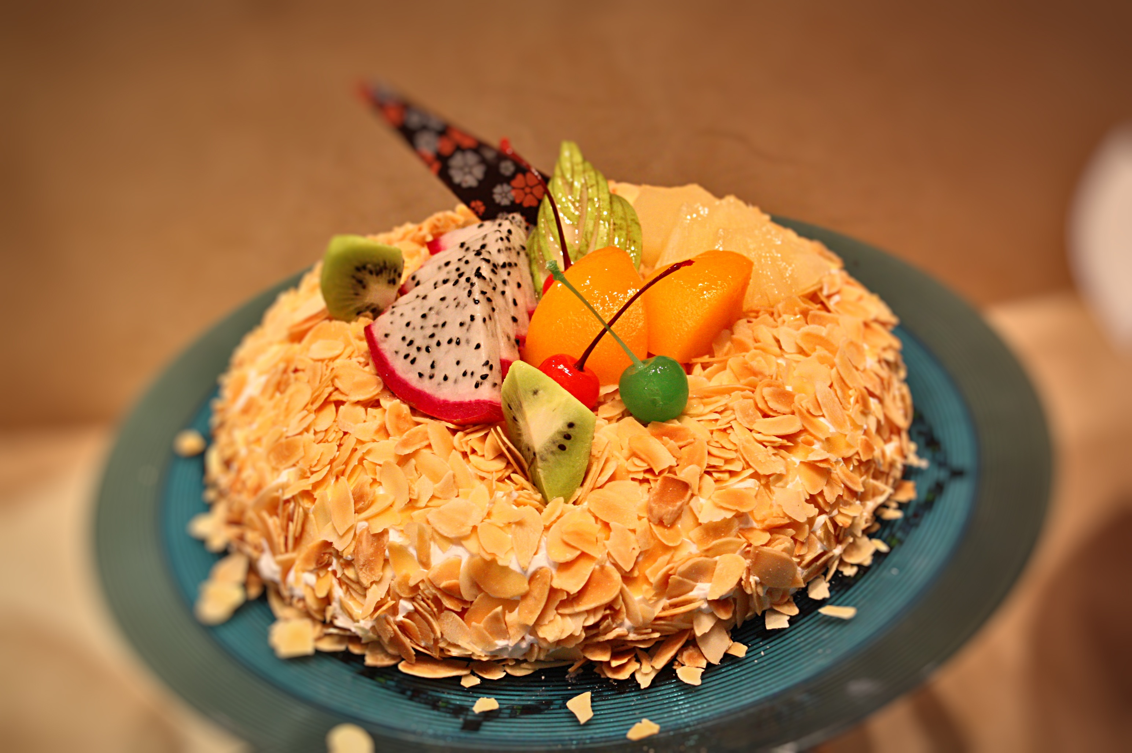
An Analogy
Imagine you work in a bakery. You are tasked to bake a cake which will sell well in the shop.
Design
“Let’s sketch the recipe”
You plan the ingredients, the baking time, the decoration style.
You’re not baking yet - just designing the recipe

Slide 7

An Analogy
Imagine you work in a bakery. You are tasked to bake a cake which will sell well in the shop.
Implementation
“Time to bake”
You follow the recipe and bake the first version of the cake.
It might not be perfect, but it’s a working prototype.
You get something tangible out of the oven.

Slide 8

An Analogy
Imagine you work in a bakery. You are tasked to bake a cake which will sell well in the shop.
Testing
“Taste test”
You slice it up and let people try it.
Maybe the frosting’s too sweet or the sponge is too dry.
You gather feedback and note what needs fixing.

Slide 9
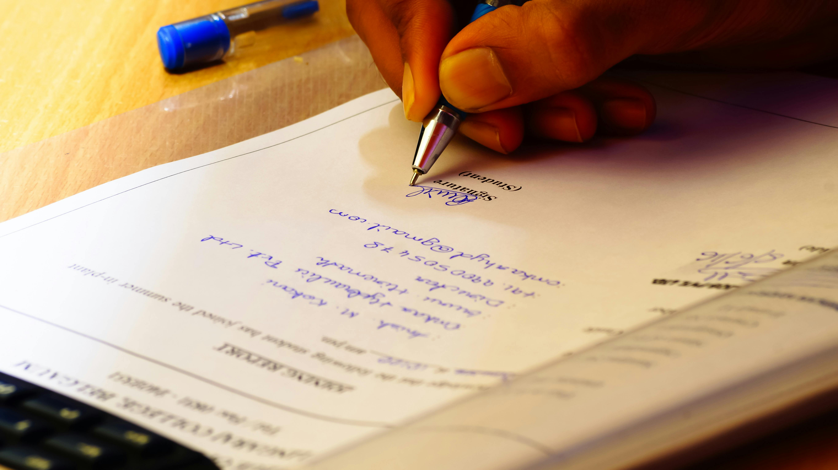
An Analogy
Imagine you work in a bakery. You are tasked to bake a cake which will sell well in the shop.
Documentation
“Write down what worked (and what didn’t).”
You jot down the adjusted recipe, the tweaks you made.
This helps you (or others) replicate or improve the cake next time.

Slide 10

An Analogy
Imagine you work in a bakery. You are tasked to bake a cake which will sell well in the shop.
Evaluation
“Was it a hit?”
You reflect: Did the cake meet expectations? Was it better than last time?
What could be improved in the next iteration?
You use this insight to start the cycle again.

Slide 11
Iterative Development
This is an example of the iterative development cycle.
There are 6 stages:
Analysis – what is the purpose of the program?
Design – how will I code the solution?
Implementation – write code to solve the problem
Testing – does my code work?
Documentation – explaining the code
Evaluation – how well does the code work?

Slide 12
Iteration
Iteration means repeating a process:
In software development, it is the term used to describe repeating or revisiting phases that may have been worked on already.
For example:
In the Testing stage, you might find a bug in your code
Then, you return to the Implementation stage to fix the bug
After, you can go back to the Testing stage to see if the bug is fixed
If it is, you can move on and complete the cycle

Slide 13
Learning intentions and success criteria
I am learning…
I can…
About hardware used to capture and process still images
How to describe image hardware
Identify and describe the uses of different still image hardware devices
Create a presentation about different types of image hardware

